Slide 1
Topic: Next-Word-prediction
Presenter name: S.Snigdha

Slide 2
Agenda
Introduction
Recurrent Neural Networks
Long Short-Term Memory
Code Implementation
Summary

Slide 3

Introduction
Natural language processing has been an area of research and used widely in different applications. We often love texting each other and find that whenever we try to type a text a suggestion poops up trying to predict the next word we want to write.
This process of prediction is one of the applications NLP deals with. We have made huge progress here and we can use Recurrent neural networks for such a process.

Slide 4
Topic one
Recurrent Neural Networks(RNN)

Slide 5
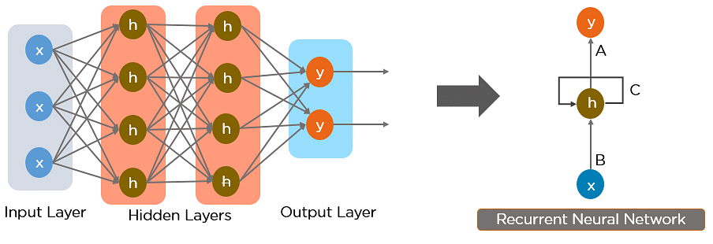
Recurrent Neural Networks
Recurrent Neural Network(RNN) is a type of Neural Network where the output from the previous step are fed as input to the current step.
In traditional neural networks, all the inputs and outputs are independent of each other.
But in cases like when it is required to predict the next word of a sentence, the previous words are required and hence there is a need to remember the previous words.
Thus RNN came into existence, which solved this issue with the help of a Hidden Layer. The main and most important feature of RNN is Hidden state, which remembers some information about a sequence.

Slide 6
Working of Recurrent Neural Network
RNN have a “memory” which remembers all information about what has been calculated.
It uses the same parameters for each input as it performs the same task on all the inputs or hidden layers to produce the output.
The input layer ‘x’ takes in the input, The middle layer ‘h’ can consist of multiple hidden layers, each with its own activation functions and weights and biases
The RNN will standardize the different activation functions and weights and biases so that each hidden layer has the same parameters. Then, instead of creating multiple hidden layers, it will create one and loop over it as many times as required.

Slide 7
Topic two
Long Short-Term Memory (LSTM)

Slide 8
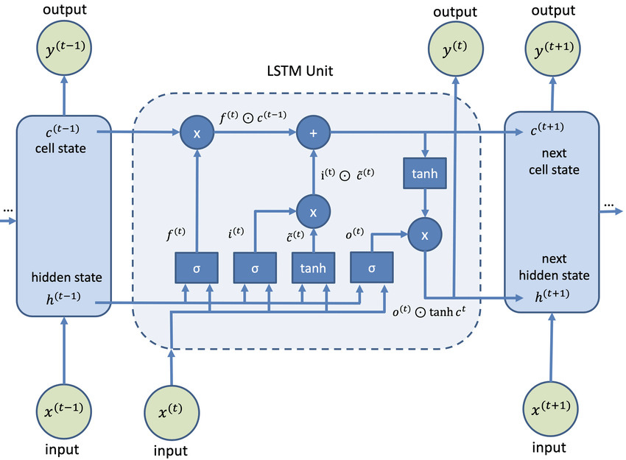
Long Short-Term Memory (LSTM)
Long Short-Term Memory Networks is a deep learning, sequential neural network that allows information to persist. It is a special type of Recurrent Neural Network which is capable of handling the vanishing gradient problem faced by RNN.
Why LSTM when we have RNN?
A sentence or phrase only holds meaning when every word in it is associated with its previous word and the next one.
LSTM, short for Long Short Term Memory, as opposed to RNN, extends it by creating both short-term and long-term memory components to efficiently study and learn sequential data. Hence, it’s great for Machine Translation, Speech Recognition, time-series analysis, etc.

Slide 9
Topic Three
Implementing Code

Slide 10
Steps for Implementing Code
Step-1: Import Libraries
Step-2: Load Files
Step-3: Pre-Process Data
Step-4: Tokenization
Step-5:Plot the Model
Step-6: Train the model
Step-7: Predict

Slide 11
Step 1: Import libraries: We use TensorFlow with Keras for our model building. We can import the LSTM model from Keras and use it.
import tensorflow as tf
from tensorflow.keras.preprocessing.text import Tokenizer
from tensorflow.keras.layers import Embedding, LSTM, Dense
from tensorflow.keras.models import Sequential
from tensorflow.keras.utils import to_categorical
from tensorflow.keras.optimizers import Adam
import pickle
import numpy as np
import os
Step 2: Load your file: let’s load the data and have a quick look at what we are going to work with:
Path = “data.txt ”

Slide 12
Step 3: Open and pre-process the data
file = open("Pride and Prejudice.txt", "r", encoding = "utf8")
# store file in list
lines = [ ]
for i in file:
lines.append(i)
# Convert list to string
data = ""
for i in lines:
data = ' '. join(lines)
#replace unnecessary stuff with space
data = data.replace('\n', '').replace('\r', '').replace('\ufeff', '').replace('“','').replace('”','') #new line, carriage return, unicode character --> replace by space
#remove unnecessary spaces
data = data.split()
data = ' '.join(data)
data[:500]
len(data)

Slide 13
Step 4: Apply tokenization and some other changes
tokenizer = Tokenizer()
tokenizer.fit_on_texts([data])
# saving the tokenizer for predict function
pickle.dump(tokenizer, open('token.pkl', 'wb'))
sequence_data = tokenizer.texts_to_sequences([data])[0]
sequence_data[:15]
X = [ ]
y = [ ]
for i in sequences:
X.append(i[0:3])
y.append(i[3])
X = np.array(X)
y = np.array(y)
print("Data: ", X[:10])
print("Response: ", y[:10])
y = to_categorical(y, num_classes=vocab_size)
y[:5]
len(sequence_data)
vocab_size = len(tokenizer.word_index) + 1
print(vocab_size)
sequences = [ ]
for i in range(3, len(sequence_data)):
words = sequence_data[i-3:i+1]
sequences.append(words)
print("The Length of sequences are: ", len(sequences))
sequences = np.array(sequences)
sequences[:10]

Slide 14
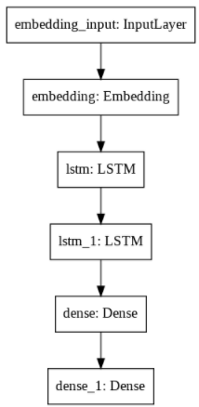
Step 5: Creating the model
model = Sequential()
model.add(Embedding(vocab_size, 10, input_length=3))
model.add(LSTM(1000, return_sequences=True))
model.add(LSTM(1000))
model.add(Dense(1000, activation="relu"))
model.add(Dense(vocab_size, activation="softmax"))
model.summary()
Step 6: Plot the model
from tensorflow import keras
from keras.utils.vis_utils import plot_model
keras.utils.plot_model(model, to_file='plot.png', show_layer_names=True)

Slide 15
Step 7: Train the model
from tensorflow.keras.callbacks import ModelCheckpoint
checkpoint = ModelCheckpoint("next_words.h5", monitor='loss', verbose=1, save_best_only=True)
model.compile(loss="categorical_crossentropy", optimizer=Adam(learning_rate=0.001))
model.fit(X, y, epochs=70, batch_size=64, callbacks=[checkpoint])

Slide 16
Step 8: Let's predict
from tensorflow.keras.models import load_model
import numpy as np
import pickle
# Load the model and tokenizer
model = load_model('next_words.h5')
tokenizer = pickle.load(open('token.pkl', 'rb'))
def Predict_Next_Words(model, tokenizer, text):
sequence = tokenizer.texts_to_sequences([text])
sequence = np.array(sequence)
preds = np.argmax(model.predict(sequence))
predicted_word = ""
for key, value in tokenizer.word_index.items():
if value == preds:
predicted_word = key
break
print(predicted_word)
return predicted_word

Slide 17
while(True):
text = input("Enter your line: ")
if text == "0":
print("Execution completed.....")
break
else:
try:
text = text.split(" ")
text = text[-3:]
print(text)
Predict_Next_Words(model, tokenizer, text)
except Exception as e:
print("Error occurred: ",e)
continue
Sample output :Enter your line: The Project Gutenberg (our input)
['The', 'Project', 'Gutenberg'] (takes last three words of our input)
literary (return next word)
Enter your line: how can you abuse your own (our input)
['abuse', 'your', 'own’] (takes last three words of our input)
children(return next word)

Slide 18
Topic four
Summary

Slide 19
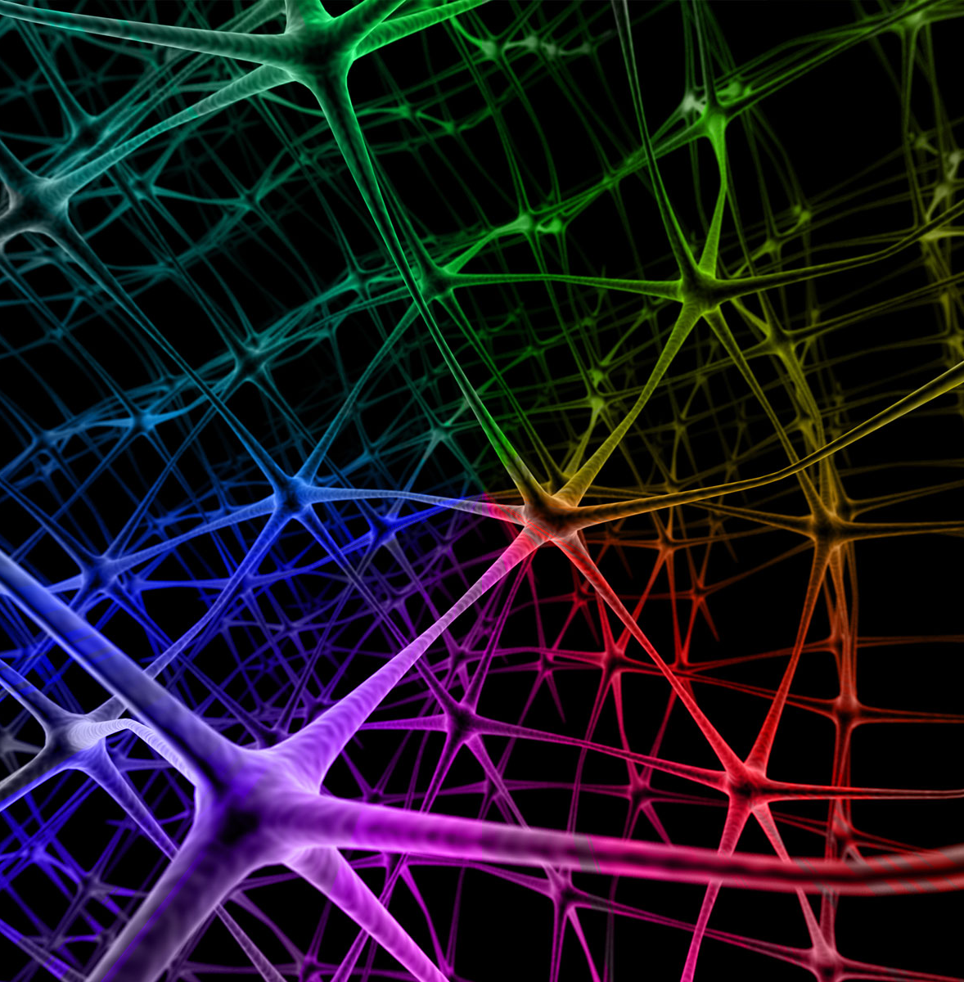
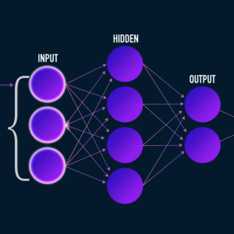
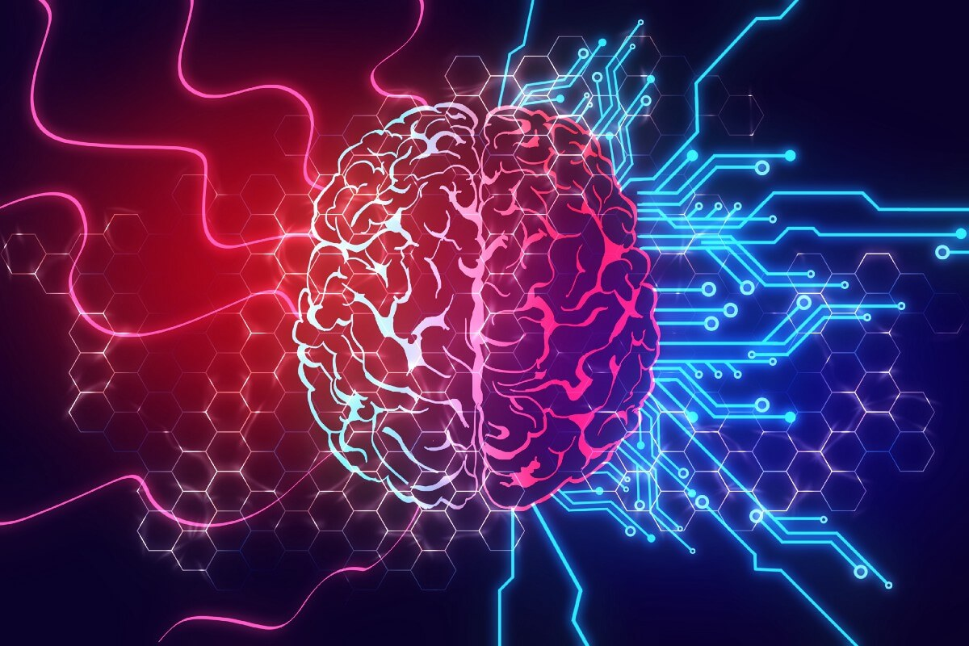
Summary
Next word prediction is the trend topic in Naturel Language Processing (NLP) for last decade. Previously, Support Vector Machines or Markov models used for next word prediction. With the improvement of technology, NLP model convert to Deep learning algorithms like Recurrent Neural Networks (RNN) and Long Short-Term Memory Networks (LSTM).
Long Short Term Memory (LSTM) networks are a type of recurrent neural network capable of learning order dependence in sequence prediction problems. A behavior required in complex problem domains like machine translation, speech recognition, and more. Even simple models require a lot of time and system resources to train due to the difficulty of training them. The hardware limitations are the only thing holding this back

Slide 20
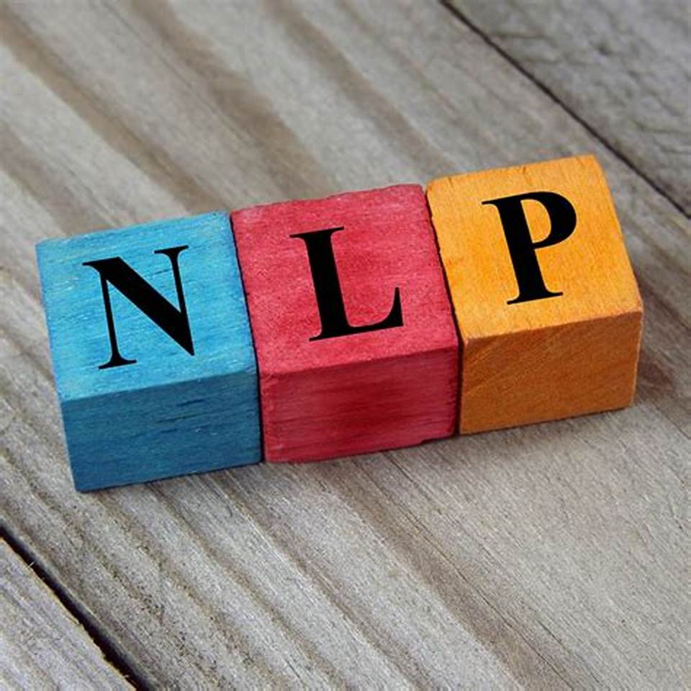

Thank you!

